Slide 1
WEB APPLICATION: SQL INJECTION
IDAN CHERNETSKY

Slide 2
WHAT IS SQL INJECTION?
SQL Injection – sometimes referred to simply as SQLi – is a common method used by attackers to manipulate and access database information that would otherwise not be displayed or provided to the website user.
SQL Injection can be used in a range of ways to cause serious problems. By levering SQL Injection, an attacker could bypass authentication, access, modify and delete data within a database. In some cases, SQL Injection can even be used to execute commands on the operating system, potentially allowing an attacker to escalate to more damaging attacks inside of a network that sits behind a firewall.
SQL Injection can be classified into two major categories – Non – Blind SQLi and Blind SQLi.

Slide 3
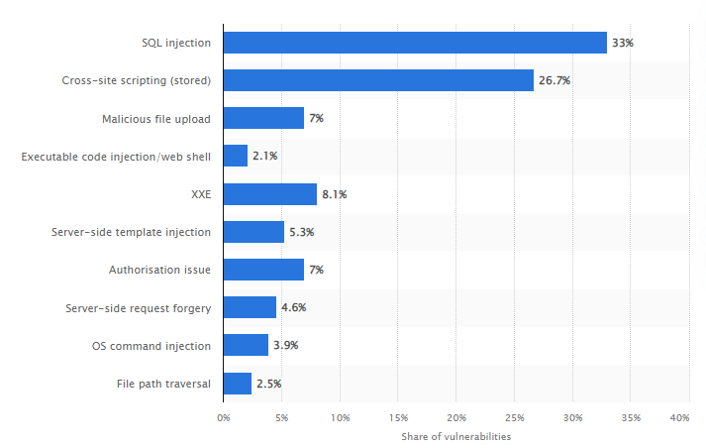
SQL INJECTION IN 2022
SQL Injection is the main source of web application critical vulnerabilities found globally in 2022, with 33 percent.
- From statista.com

Slide 4
THE LARGEST SQL INJECTION ATTACKS IN HISTORY
Heartland Payment Systems (2008)
A Digital Heist
In 2008, hacker Albert Gonzalez led a major SQL Injection attack on Heartland Payment Systems, compromising 130 million credit and debit card numbers. Heartland faced financial damages of over $145 million and implemented stronger cybersecurity measures, including end-to-end encryption. Gonzalez was later sentenced to 20 years in prison, highlighting the severe impact and risks associated with SQL Injection attacks.

Slide 5
THE LARGEST SQL INJECTION ATTACKS IN HISTORY
Sony Pictures (2011)
A Silver Screen Nightmare
In 2011, hacker group LulzSec carried out an SQL Injection attack on Sony Pictures, causing widespread damage. Confidential information, including documents and unreleased films, was exposed. Sony Pictures suffered a loss of $15 million and faced significant reputation damage. They responded by strengthening their cybersecurity measures. LulzSec members faced legal consequences, highlighting the reach of cyber law enforcement.

Slide 6
THE LARGEST SQL INJECTION ATTACKS IN HISTORY
Yahoo! (2012)
A Digital Titan Stumbles
In 2012, Yahoo! experienced a severe blow when the hacker group D33Ds Company executed an SQL Injection attack. They gained access to personal data belonging to 450,000 Yahoo! users worldwide, exposing usernames, email addresses, and weakly encrypted passwords. The breach damaged Yahoo!'s reputation, resulting in legal battles and settlements. Yahoo! used the incident as a catalyst for improving security measures and promoting better password practices. The attack also led to the dismantling of D33Ds Company by international law enforcement agencies.

Slide 7
WHAT ARE THE SQL QUERIES?
SQL (Structured Query Language) is utilized to interact with a database and common statements such as select, insert, delete, update, and others. Many popular database structures (Oracle, Access, Microsoft SQL Server, and others) are accessible with SQL commands, although each provides additional proprietary functions, as well.
SQL queries are SQL commands that include parameters such as database actions to be taken, content to be included, and filters to be applied. A simple example is:
SELECT * FROM PAYROLL
WHERE status=’active’
Order by State, City
This command will select all records from a table named PAYROLL where the employee status is active and sort the results by State, then City.
Using SQL injection techniques, a hacker can alter the SQL query to remove the ‘active’ selection criteria and gain access to all employees in the PAYROLL database, or worse – change the SELECT command to DELETE.

Slide 8
HOW TO EXPLOIT VULNERABILITIES
SQL has many types of commands that a creative hacker can use in order to harm a database or use it’s data to get access to web application.
A hacker can use the following commands to cause critical damage to databases and use their data to harm a company, a business or a private person:
SELECT - extracts data from a database -> can help a hacker get info from a database.
UPDATE - updates data in a database -> can help a hacker change important data in a database.
DELETE - deletes data from a database -> can help a hacker delete valuable info.
INSERT INTO - inserts new data into a database -> can help a hacker inject malicious info or inject his own user to a website without registration.

Slide 9
TWO SQL INJECTION CATEGORIES
01
02
Non - Blind SQLi
Blind SQLi

Slide 10
Non - Blind SQLi
01
Error-based SQLi
Union-based SQLi

Slide 11
01
Non - Blind SQLi
Error-based SQLi
Error-based SQLi is an in-band SQL Injection technique that relies on error messages thrown by the database server to obtain information about the structure of the database. In some cases, error-based SQL injection alone is enough for an attacker to enumerate an entire database. While errors are very useful during the development phase of a web application, they should be disabled on a live site, or logged to a file with restricted access instead.

Slide 12
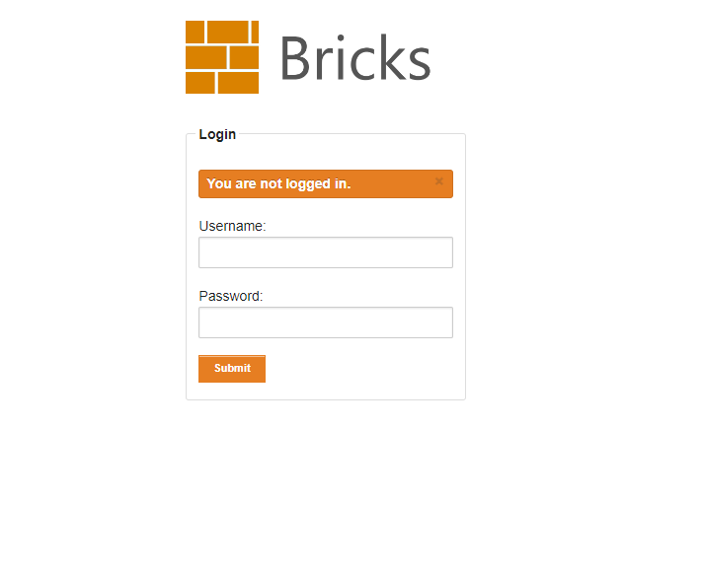
01
Non - Blind SQLi- Error-based SQLi
Loging in without a user:
We are currently have no access to the website below:

Slide 13

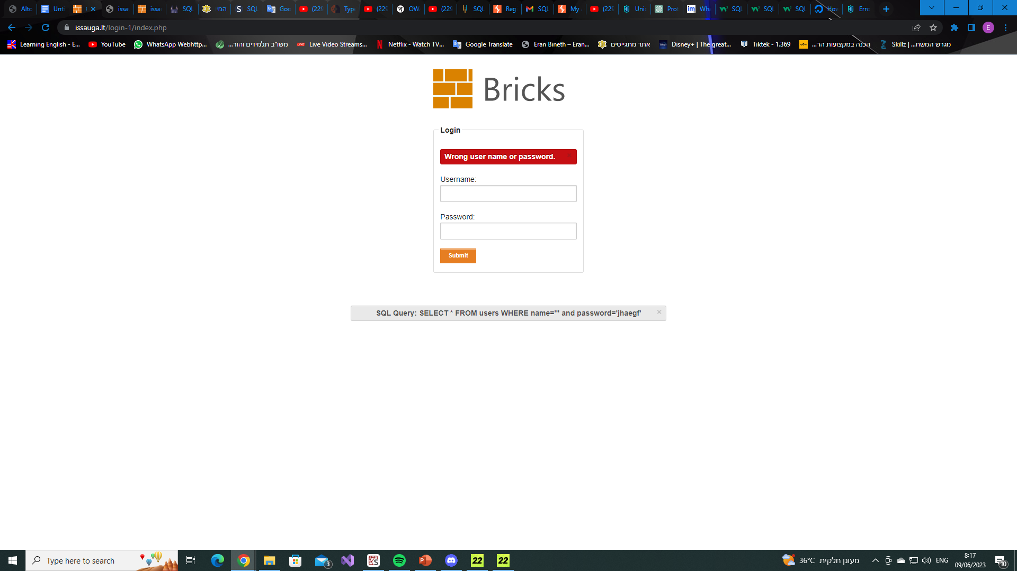
01
Non - Blind SQLi- Error-based SQLi
Loging in without a user:
We will enter a ‘ to see if we can detect a vulnerability:
We can exploit the ERROR we got to log into the website

Slide 14
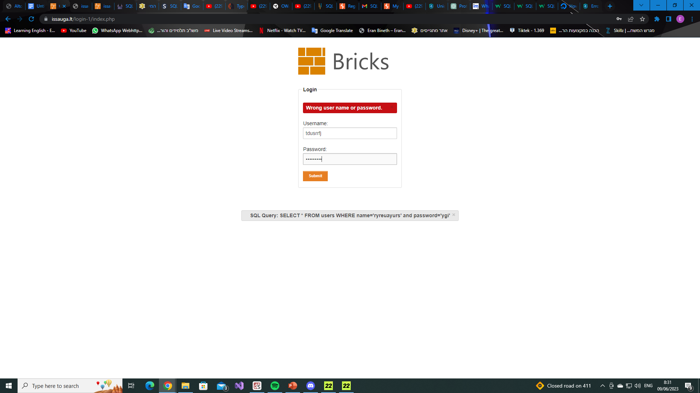
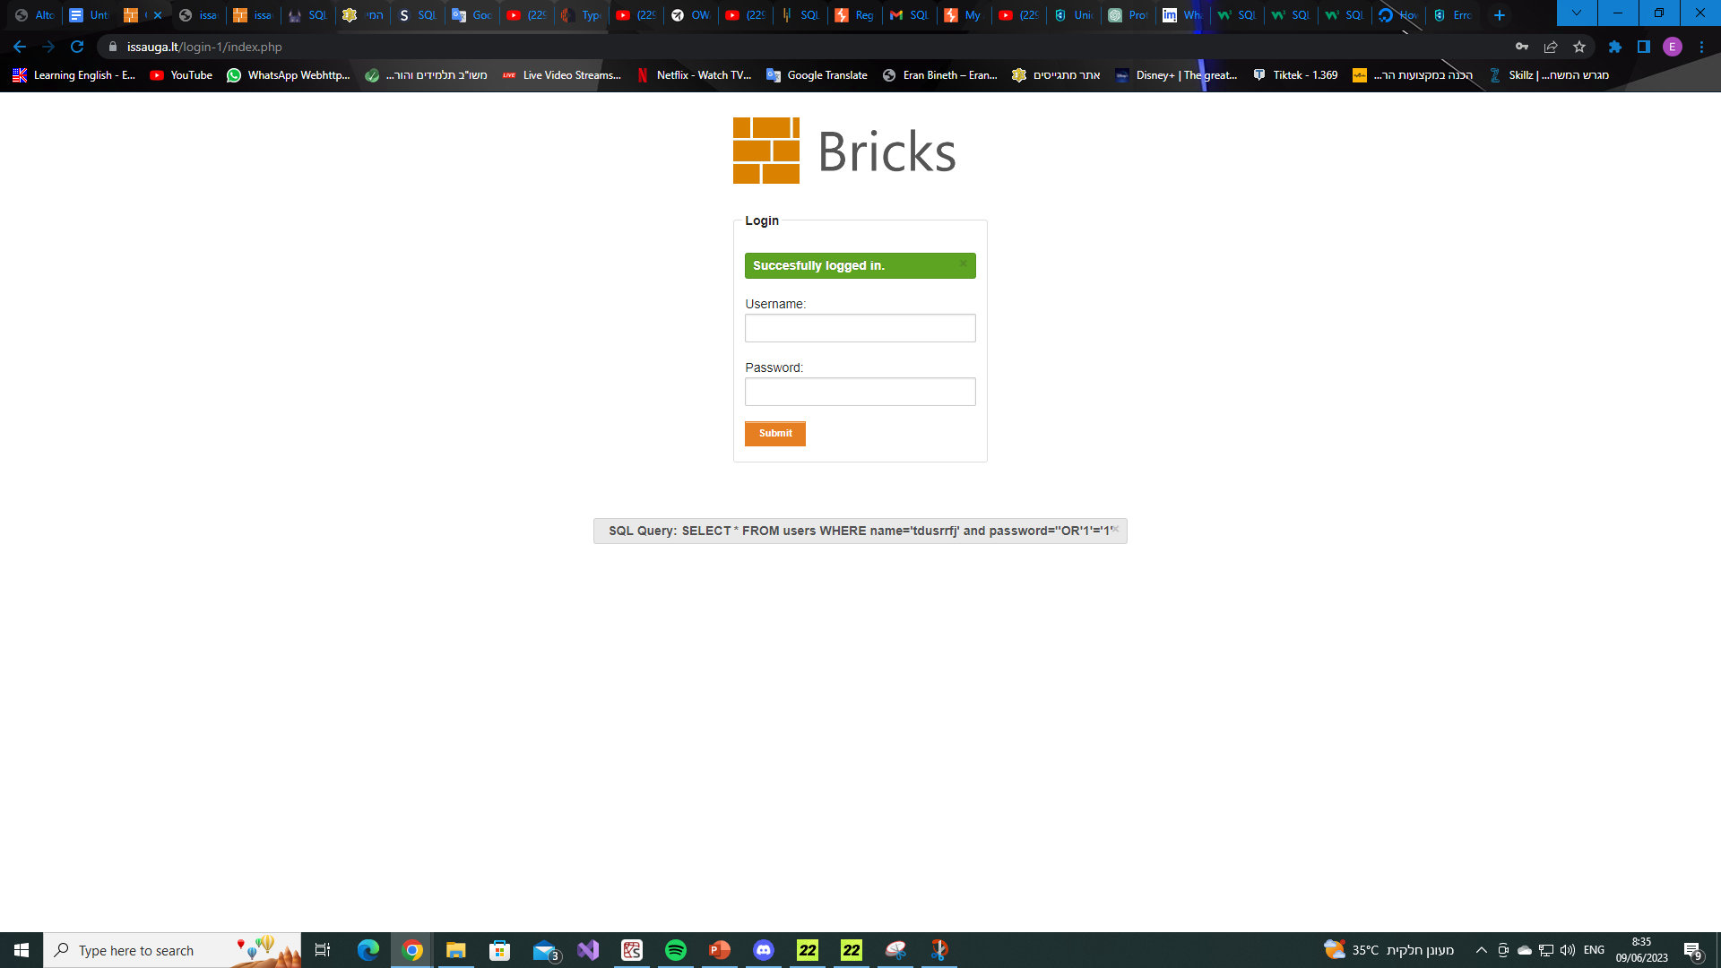
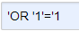
01
Non - Blind SQLi- Error-based SQLi
Loging in without a user:
By entering ‘OR’1’=‘1 as the password we can trick the query to log us in. The statement 1=1 will always be TRUE, therefore we are able to log into the website.

Slide 15
01
Non - Blind SQLi
Union-based SQLi
Union-based SQLi is an in-band SQL injection technique that leverages the UNION SQL operator to combine the results of two or more SELECT statements into a single result which is then returned as part of the HTTP response.

Slide 16
01
Non - Blind SQLi - Union-based SQLi
Union Operator
Table_A:
Table_B:
employeeID | name | age
1001 | Bob | 23
1004 | Alice | 35
1002 | John | 18
1017 | Amir | 45
1008 | Sarah | 36
employeeID | name | age
1020 | David | 54
1005 | Alex | 29

Slide 17
01
Non - Blind SQLi - Union-based SQLi
employeeID | name | age
1001 | Bob | 23
1004 | Alice | 35
1002 | John | 18
1017 | Amir | 45
1008 | Sarah | 36
1020 | David | 54
1005 | Alex | 29
SELECT employeeID, name, age
FROM Table_A
UNION
SELECT employeeID, name, age
FROM Table_B
Table_A
Table_B

Slide 18
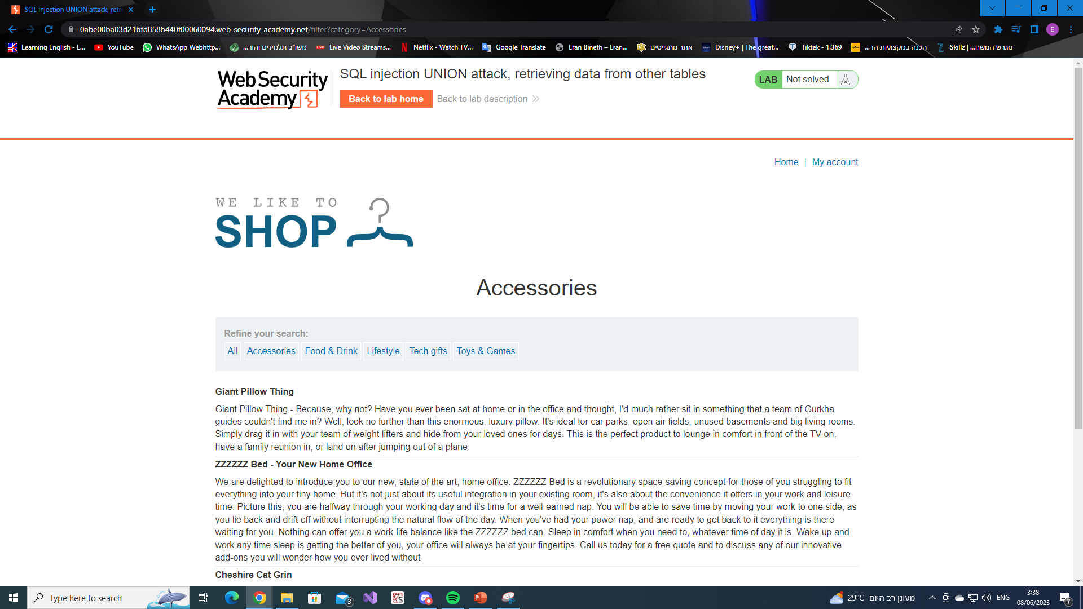
01
Non - Blind SQLi - Union-based SQLi

Slide 19
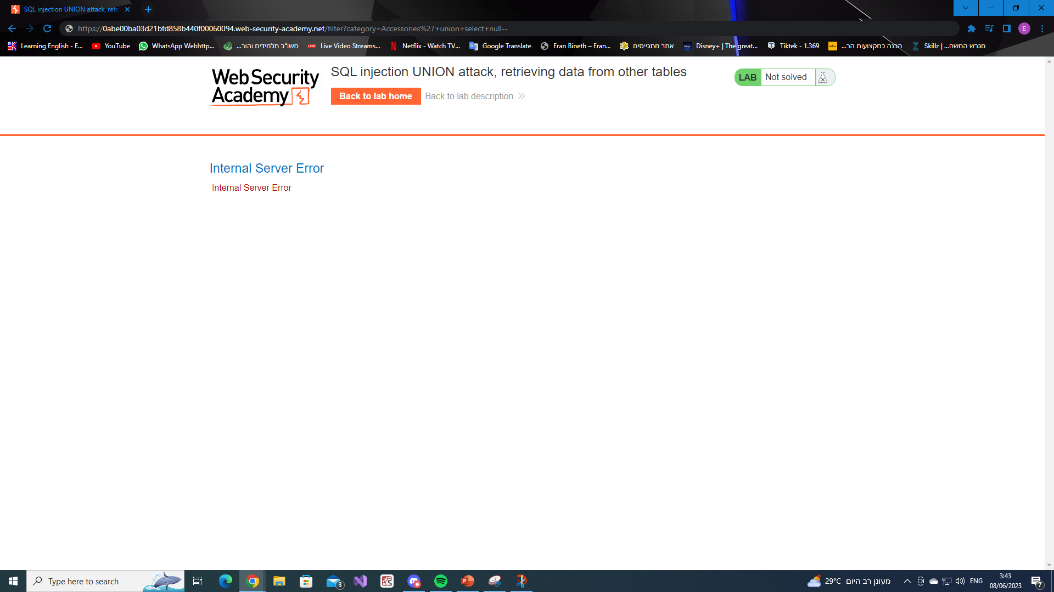
01
Non - Blind SQLi - Union-based SQLi
To combine two tables
The number of columns the table has
We got an ERROR which means that the number of columns is incorrect

Slide 20
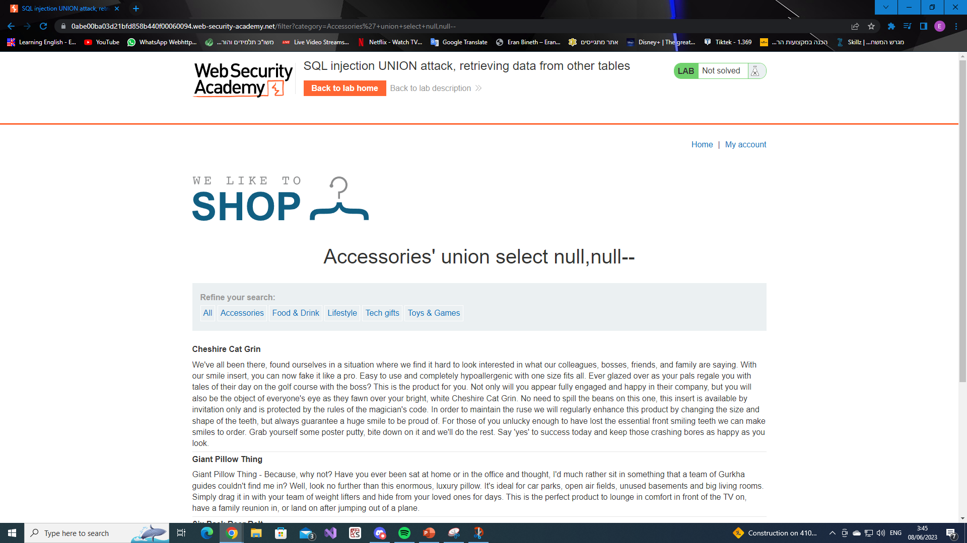
01
Non - Blind SQLi - Union-based SQLi
For two columns there was no ERROR

Slide 21
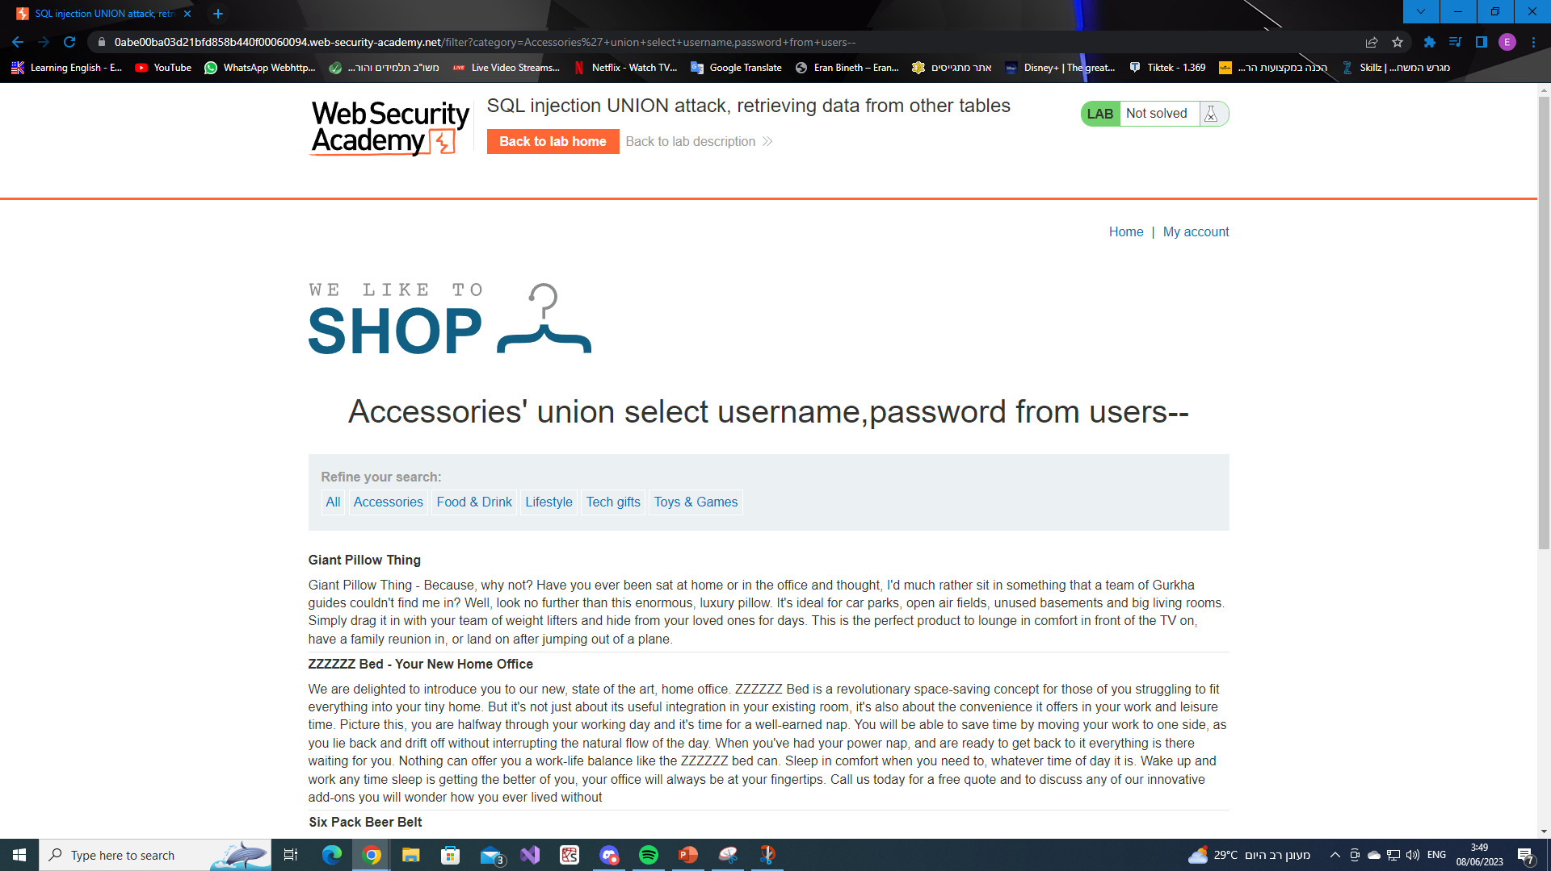
01
Non - Blind SQLi - Union-based SQLi
We are looking for a username and a password

Slide 22
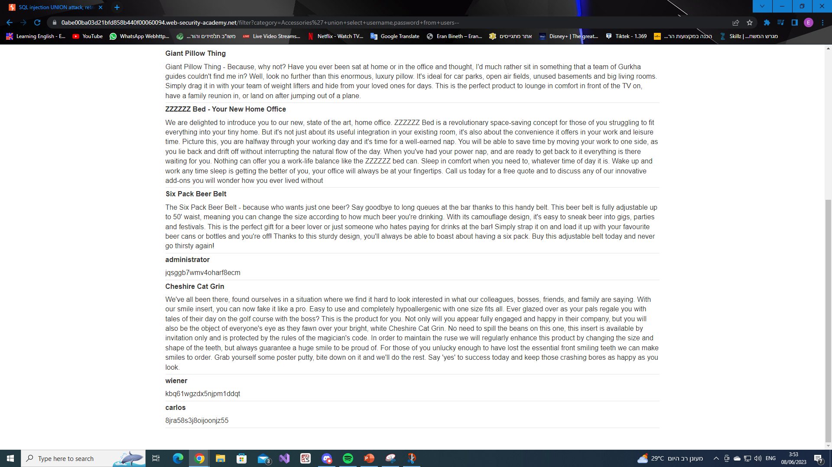
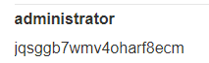
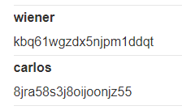
01
Non - Blind SQLi- Union-based SQLi

Slide 23
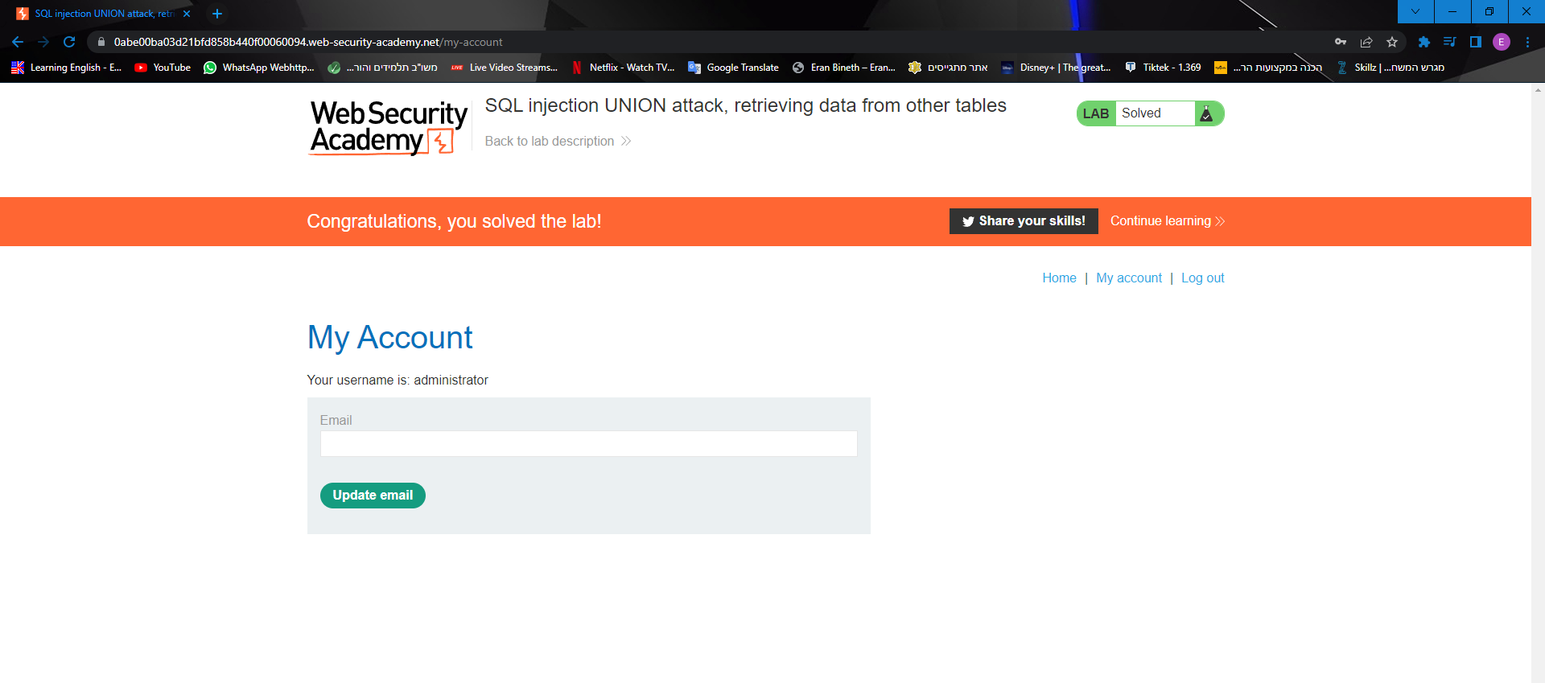
01
Non - Blind SQLi- Union-based SQLi
Using the administrator’s username and password we were able to log into the website.

Slide 24
TWO SQL INJECTION CATEGORIES
01
02
Non - Blind SQLi
Blind SQLi

Slide 25
Blind SQLi
02
Boolean-based Blind SQLi
Time-based Blind SQLi

Slide 26

02
Blind SQLi
Burp Suite
Burp Suite is a comprehensive platform for performing web application security testing. It is widely used by security professionals, ethical hackers, and penetration testers to identify vulnerabilities and assess the security of web applications.
Burp Suite offers a range of tools and features that assist in various stages of the security testing process. Some of its key components include:
Proxy: Burp Suite acts as an intercepting proxy, allowing users to capture and modify web traffic between the client and the server. This enables users to analyze requests and responses, manipulate data, and identify security flaws.
The cookie session and tracking ID.
“welcome back” massage -> the tracking ID already exists in the database.

Slide 27
02
Blind SQLi
Burp Suite
Scanner: The scanner module automates the process of identifying common security issues, such as cross-site scripting (XSS), SQL injection, and more. It scans the target application for vulnerabilities and generates detailed reports.
Spider: The spider tool helps in mapping the application's content and functionality by automatically exploring and identifying all accessible pages and resources. This aids in comprehensively testing the application's attack surface.
Intruder: This feature facilitates automated attacks by allowing users to define and customize payloads, target specific parameters, and perform brute-force or fuzzing attacks. It helps identify vulnerabilities that may arise from improper input handling.
The cookie session and tracking ID.
“welcome back” massage -> the tracking ID already exists in the database.

Slide 28
02
Blind SQLi
Burp Suite
Repeater: The repeater module provides a simple way to modify and replay individual requests to observe their impact on the application. It allows for manual testing and fine-tuning of attacks or inputs.
Sequencer: This tool is used to analyze the randomness and quality of session tokens or other important values generated by the application. It helps identify weaknesses that could be exploited by an attacker to guess or predict values.
In addition to these core functionalities, Burp Suite also offers other useful features like an encoder/decoder, comparer, extensibility through an API, and a wide range of plugins developed by the Burp Suite community.
It is important to note that Burp Suite should be used responsibly and with proper authorization from the owners of the target application. It is primarily intended for security testing purposes and not for any malicious activities.
The cookie session and tracking ID.
“welcome back” massage -> the tracking ID already exists in the database.

Slide 29
02
Blind SQLi
Boolean-based Blind SQLi
Boolean-based SQL Injection is an inferential (blind) SQL Injection technique that relies on sending an SQL query to the database which forces the application to return a different result depending on whether the query returns a TRUE or FALSE result.
Depending on the result, the content within the HTTP response will change, or remain the same. This allows an attacker to infer if the payload used returned true or false, even though no data from the database is returned. This attack is typically slow (especially on large databases) since an attacker would need to enumerate a database, character by character.

Slide 30
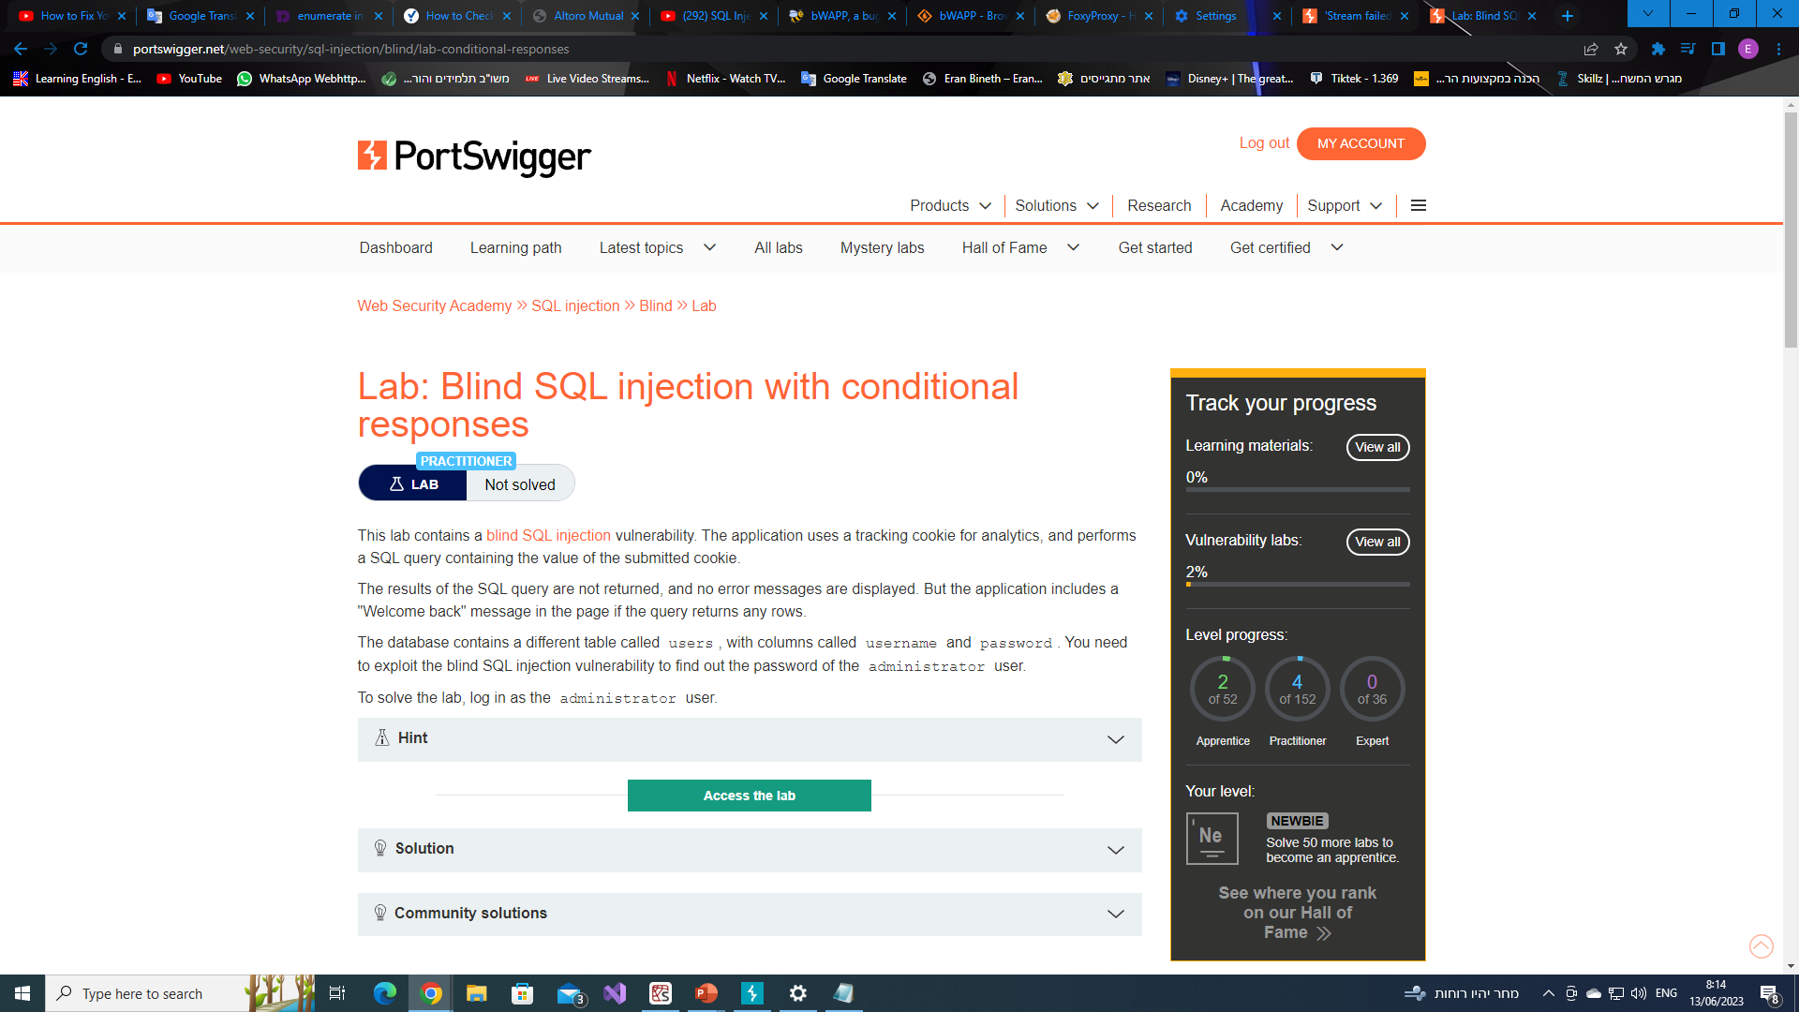
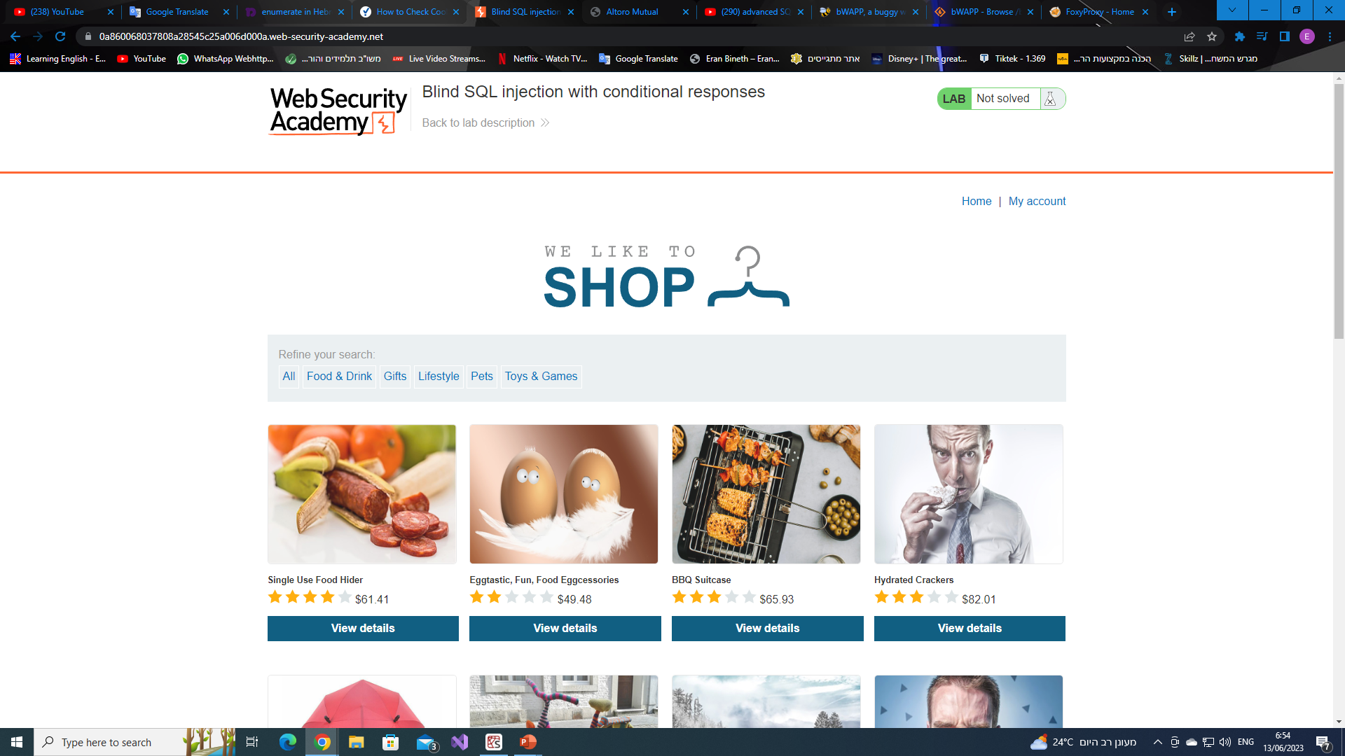
02
Blind SQLi - Boolean-based Blind SQLi
Vulnerabilities – tracking cookie.
Goal – find the administrator password and log in.
The second time we visit the website we will get a “welcome back” massage since we already visited the website before and our tracking cookie is in the database.

Slide 31
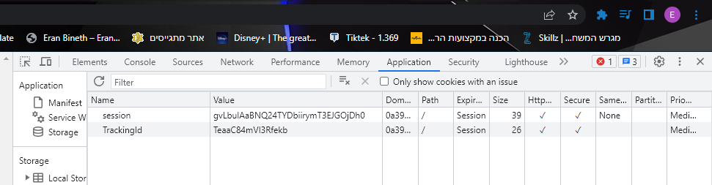
02
Blind SQLi - Boolean-based Blind SQLi
By clicking on “inspect” we can find the tracking ID of our cookie.
The cookie session and tracking ID.

Slide 32
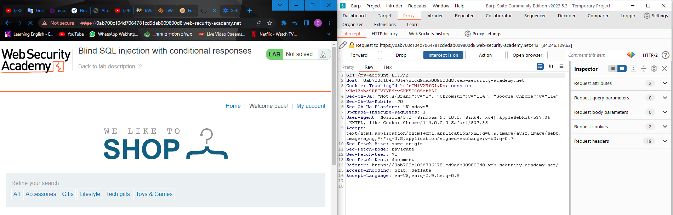
Blind SQLi - Boolean-based Blind SQLi
We will than create a new project in Burp Suite and catch the HTTP request (that has the cookie’s tracking ID) by clicking again on the “home” button and getting the “Welcome back!” massage since we already visited the website.
The cookie session and tracking ID.
“welcome back” massage -> the tracking ID already exists in the database.
The Tracking ID

Slide 33
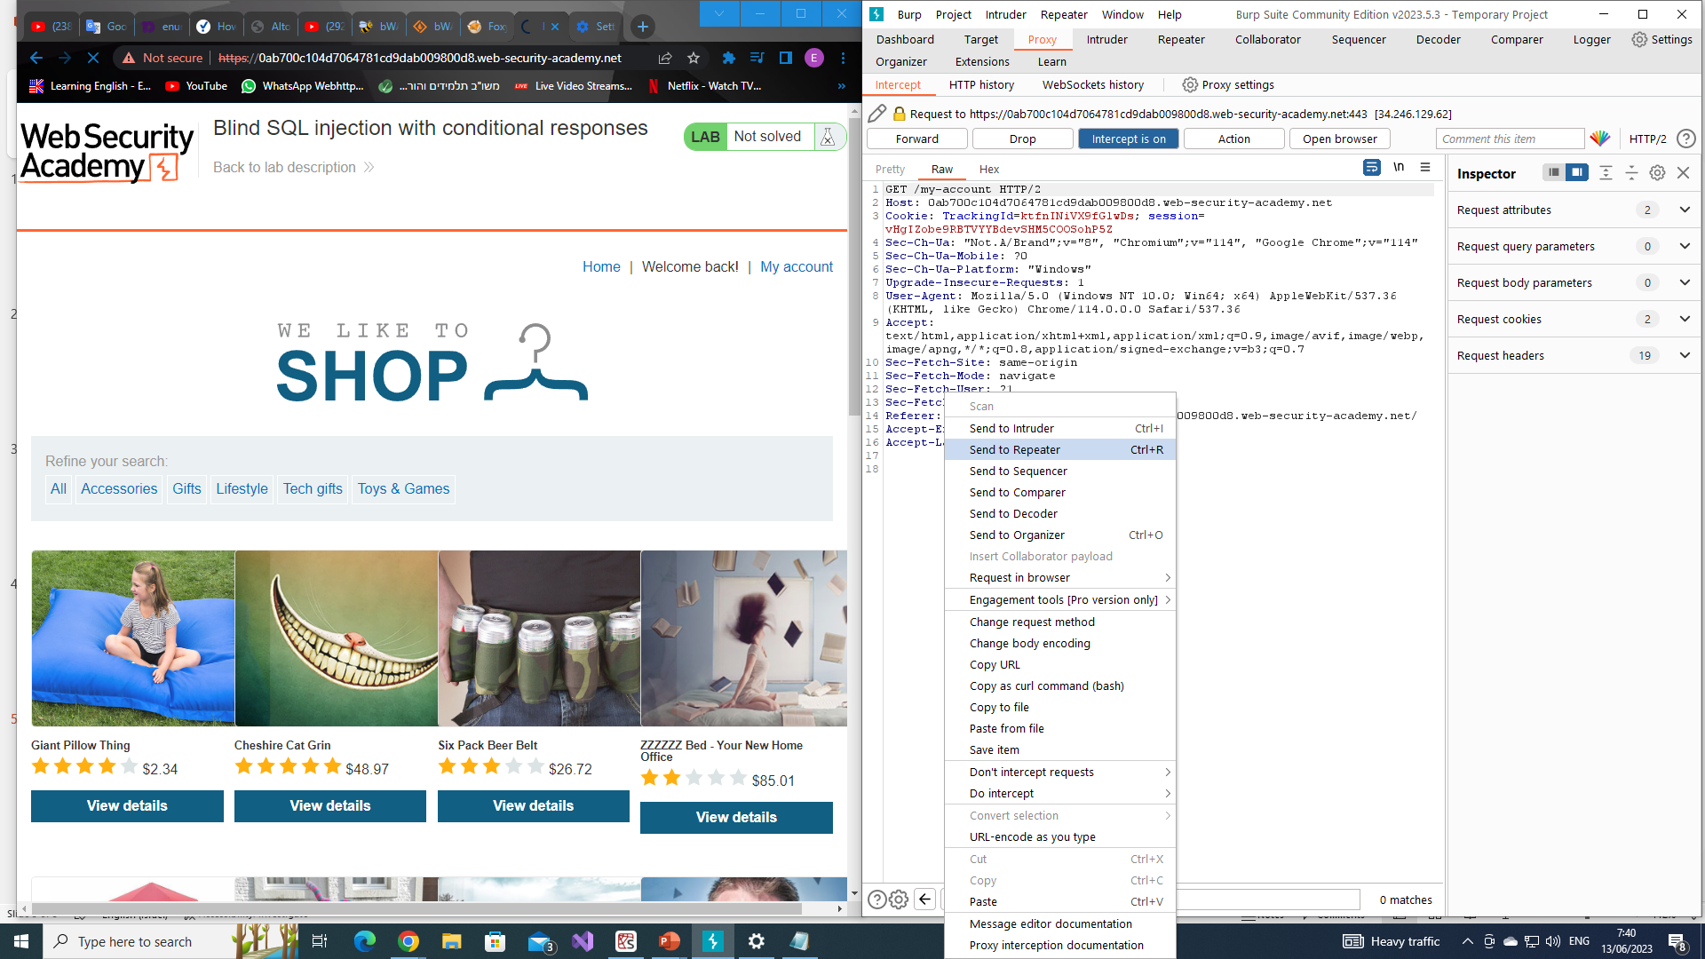
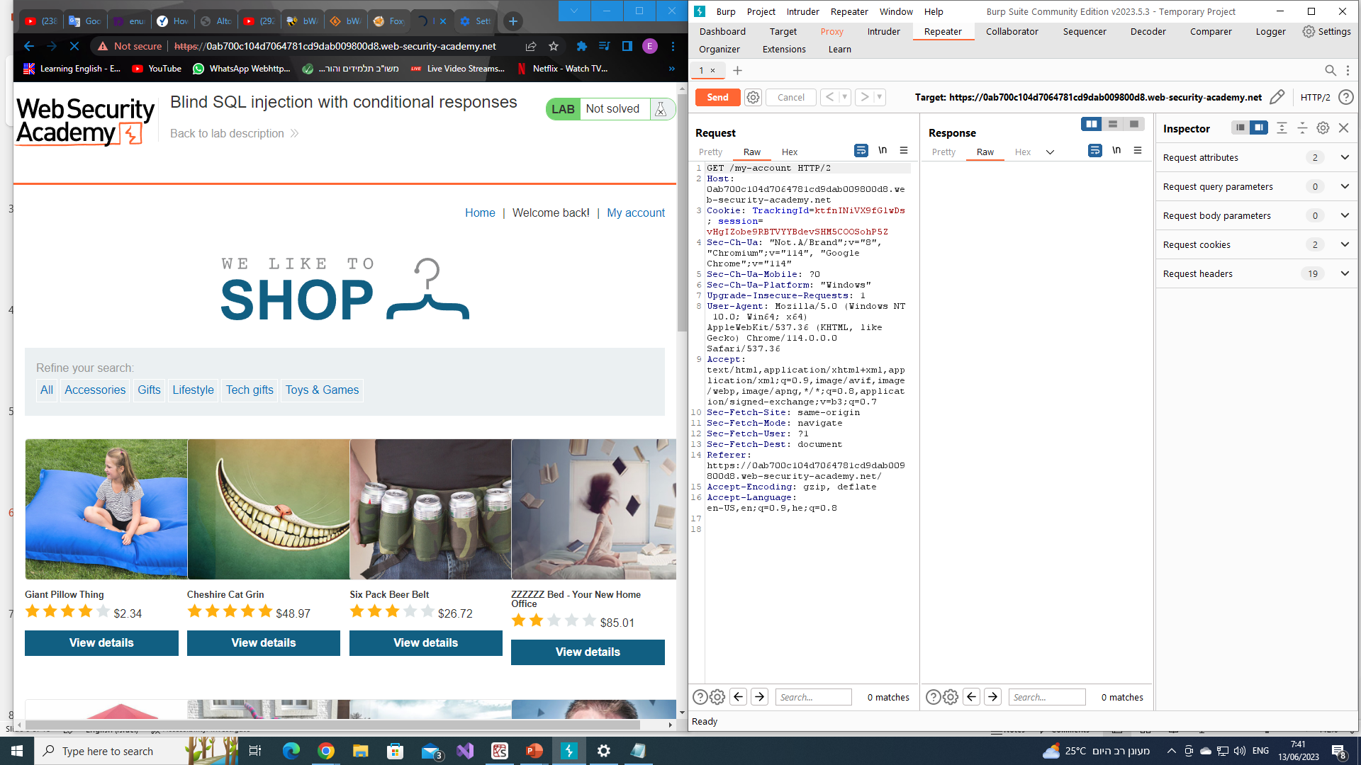
Blind SQLi - Boolean-based Blind SQLi
Moving the HTTP request to the Repeater in order to start testing the application by sending many HTTP requests with additions to the Tracking ID .
The cookie session and tracking ID.
“welcome back” massage -> the tracking ID already exists in the database.

Slide 34
Blind SQLi - Boolean-based Blind SQLi
The query that searches the Tracking ID in the database will most likely look something like this:
SELECT trackingID FROM trackingTable WHERE trackingID=‘t1YkuvhUkEJjYDKe’
By adding many types of additional queries we will test the web application and it’s vulnerability
We will test the application by forcing a TRUE and FALSE cases – changing the tracking ID (the vulnerability) and getting a False statement (no “welcome back” massage) will assure us that the tracking ID is indeed vulnerable.

Slide 35
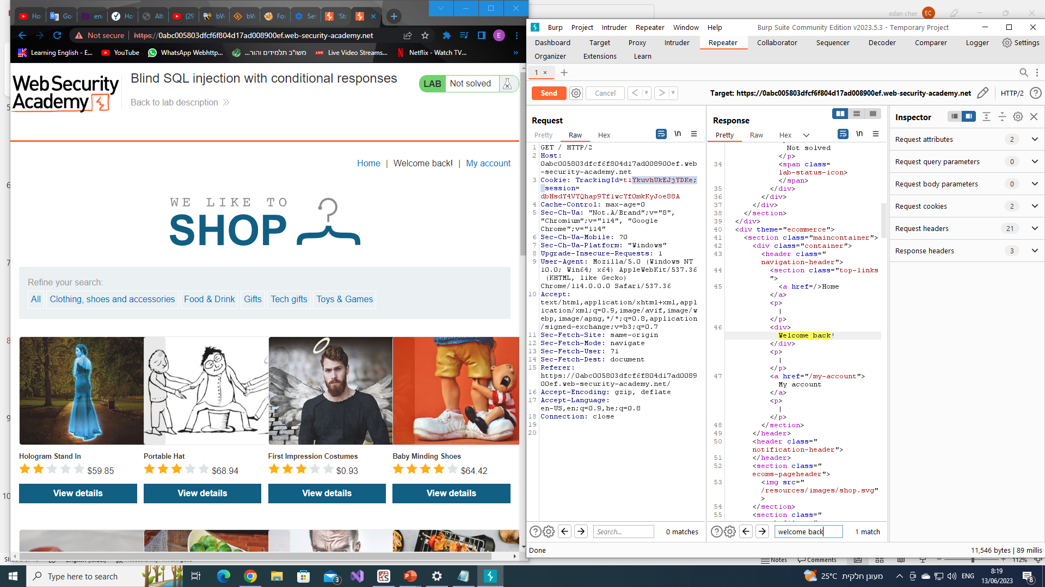

Blind SQLi - Boolean-based Blind SQLi
T-ID = ‘t1YkuvhUkEJjYDKe’ -> TRUE
T-ID = ‘t1YkuvhUkEJjYDKeH’ -> FALSE
The cookie session and tracking ID.
“welcome back” massage -> the tracking ID already exists in the database.

Slide 36
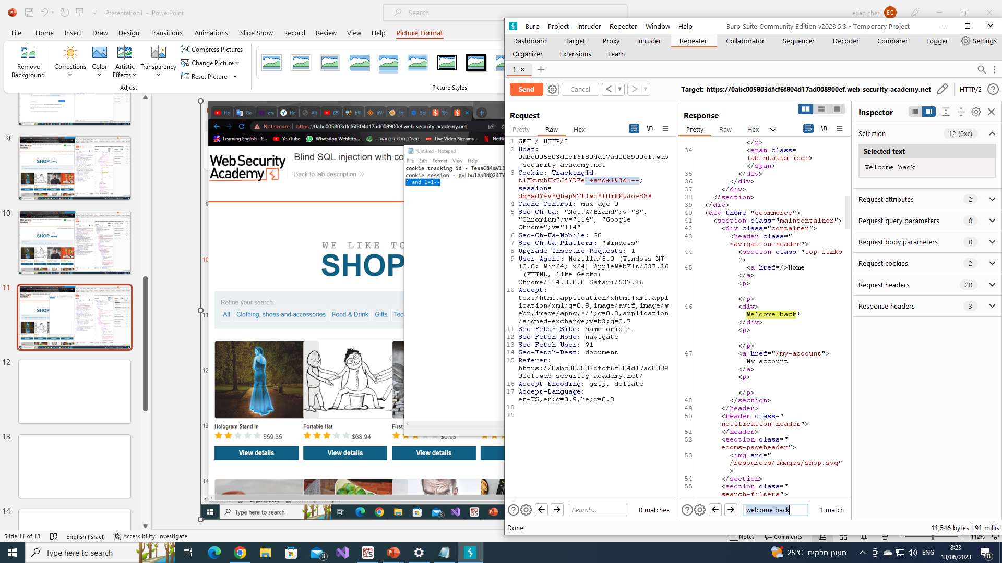
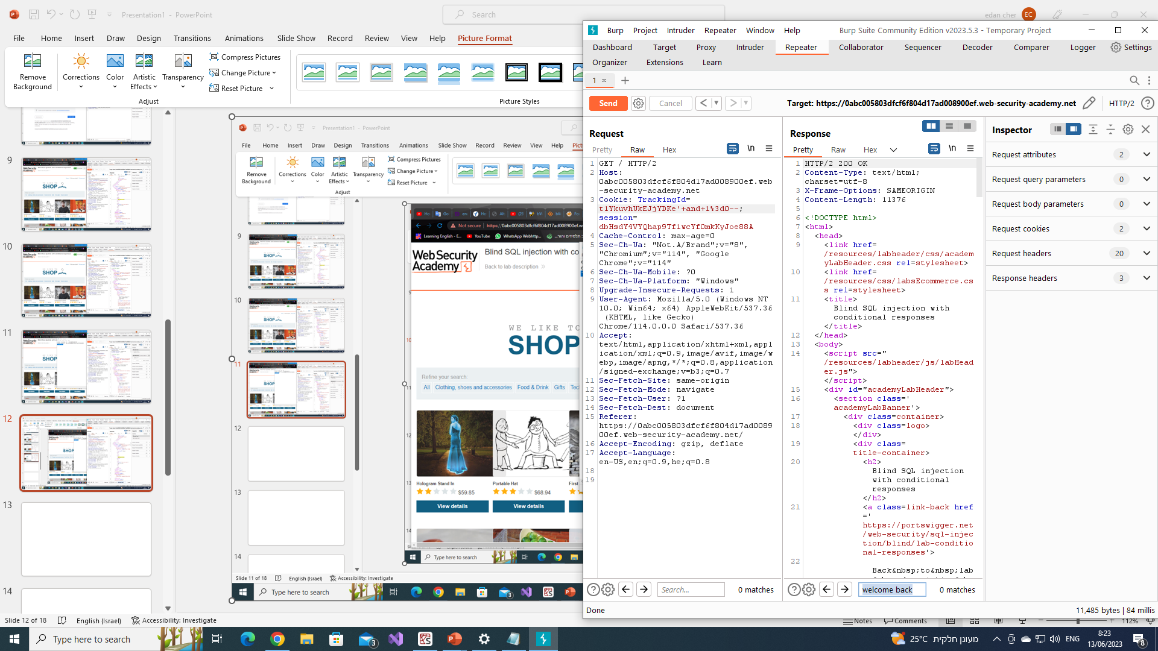
Blind SQLi - Boolean-based Blind SQLi
We will add to the original query –
' and 1=1-- -> TRUE ' and 1=0-- -> FALSE
in order to keep testing it.

Slide 37
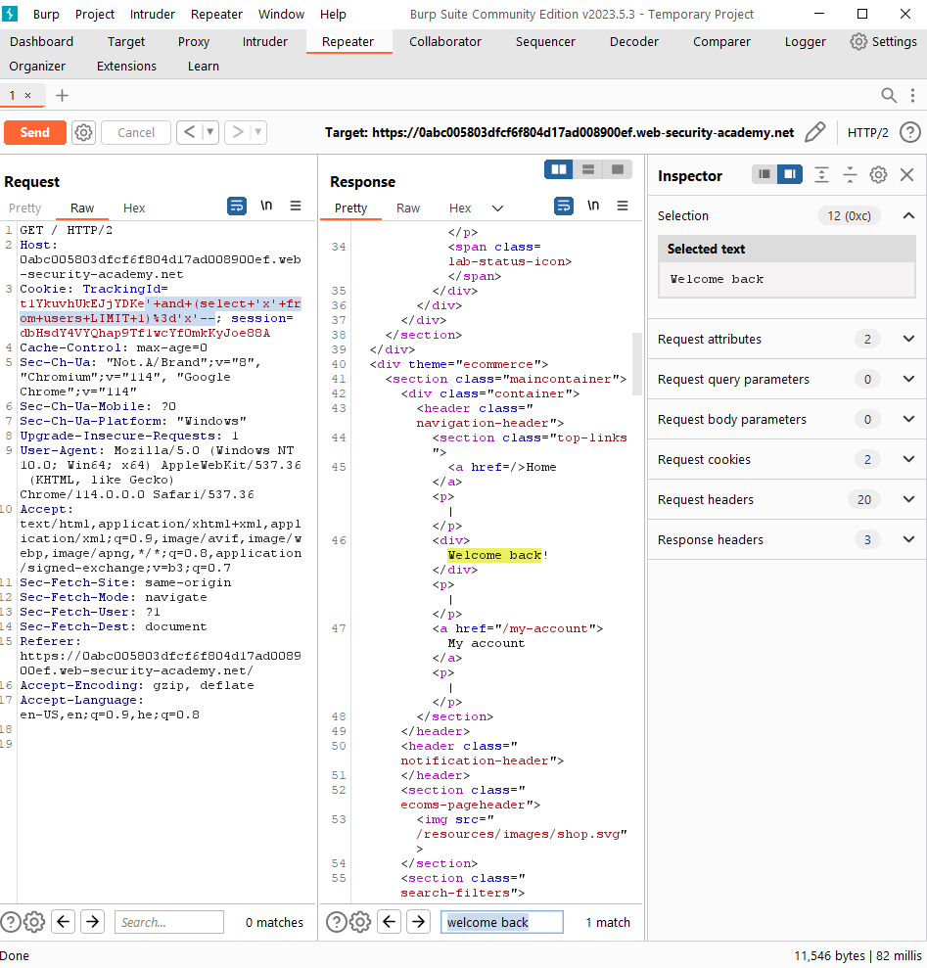
Blind SQLi - Boolean-based Blind SQLi
We will add to the original query –
' and (select 'x' from users LIMIT 1)=‘x’–-
to make sure that the users table exists.
' and (select 'x' from users LIMIT 1)=‘x’–-
The users table exists.

Slide 38
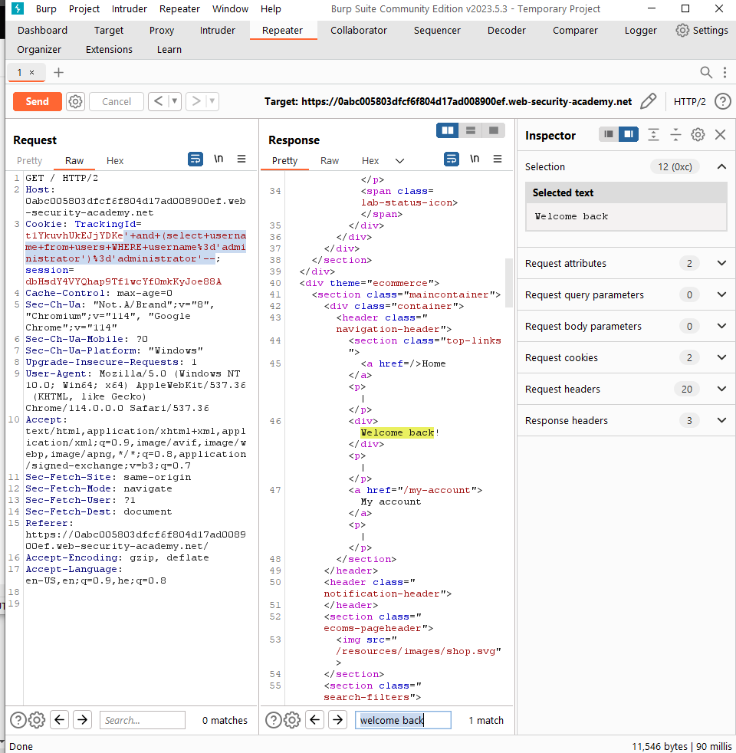
Blind SQLi - Boolean-based Blind SQLi
We will add to the original query –
' and (select username from users WHERE username='administrator')='administrator'--to make sure that the administrator user exists.
' and (select username from users WHERE username='administrator')='administrator'--
The administrator user exists.

Slide 39
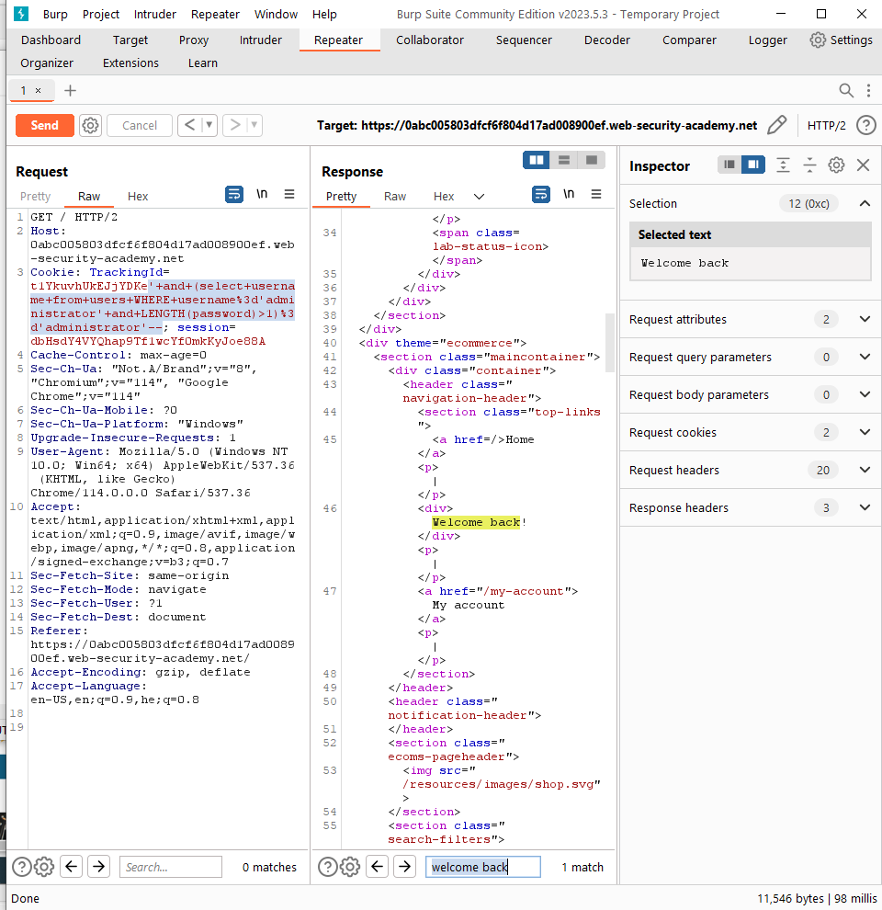
Blind SQLi - Boolean-based Blind SQLi
We will add to the original query –
' and (select username from users WHERE username='administrator' and LENGTH(password)>1)='administrator’–-
to find the length of the administrator password.
' and (select username from users WHERE username='administrator' and LENGTH(password)>1)='administrator’–-
The password is longer than 1 character.

Slide 40
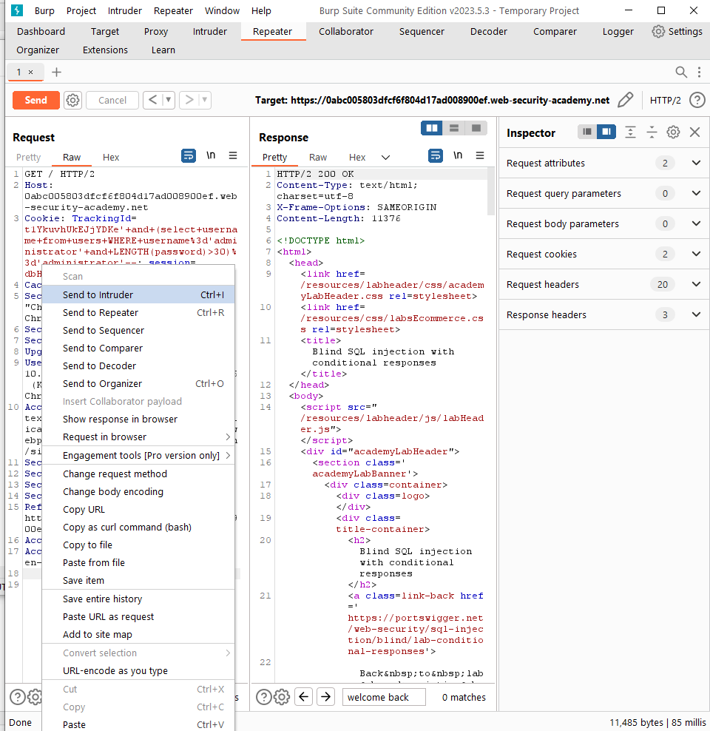
Blind SQLi - Boolean-based Blind SQLi
We will add to the original query –
' and (select username from users WHERE username='administrator' and LENGTH(password)>30)='administrator’–-
to find the length of the administrator password.
The password is shorter than 30 characters.
' and (select username from users WHERE username='administrator' and LENGTH(password)>30)='administrator’–-
We will send the HTTP request to the intruder to determine the length of the password.

Slide 41
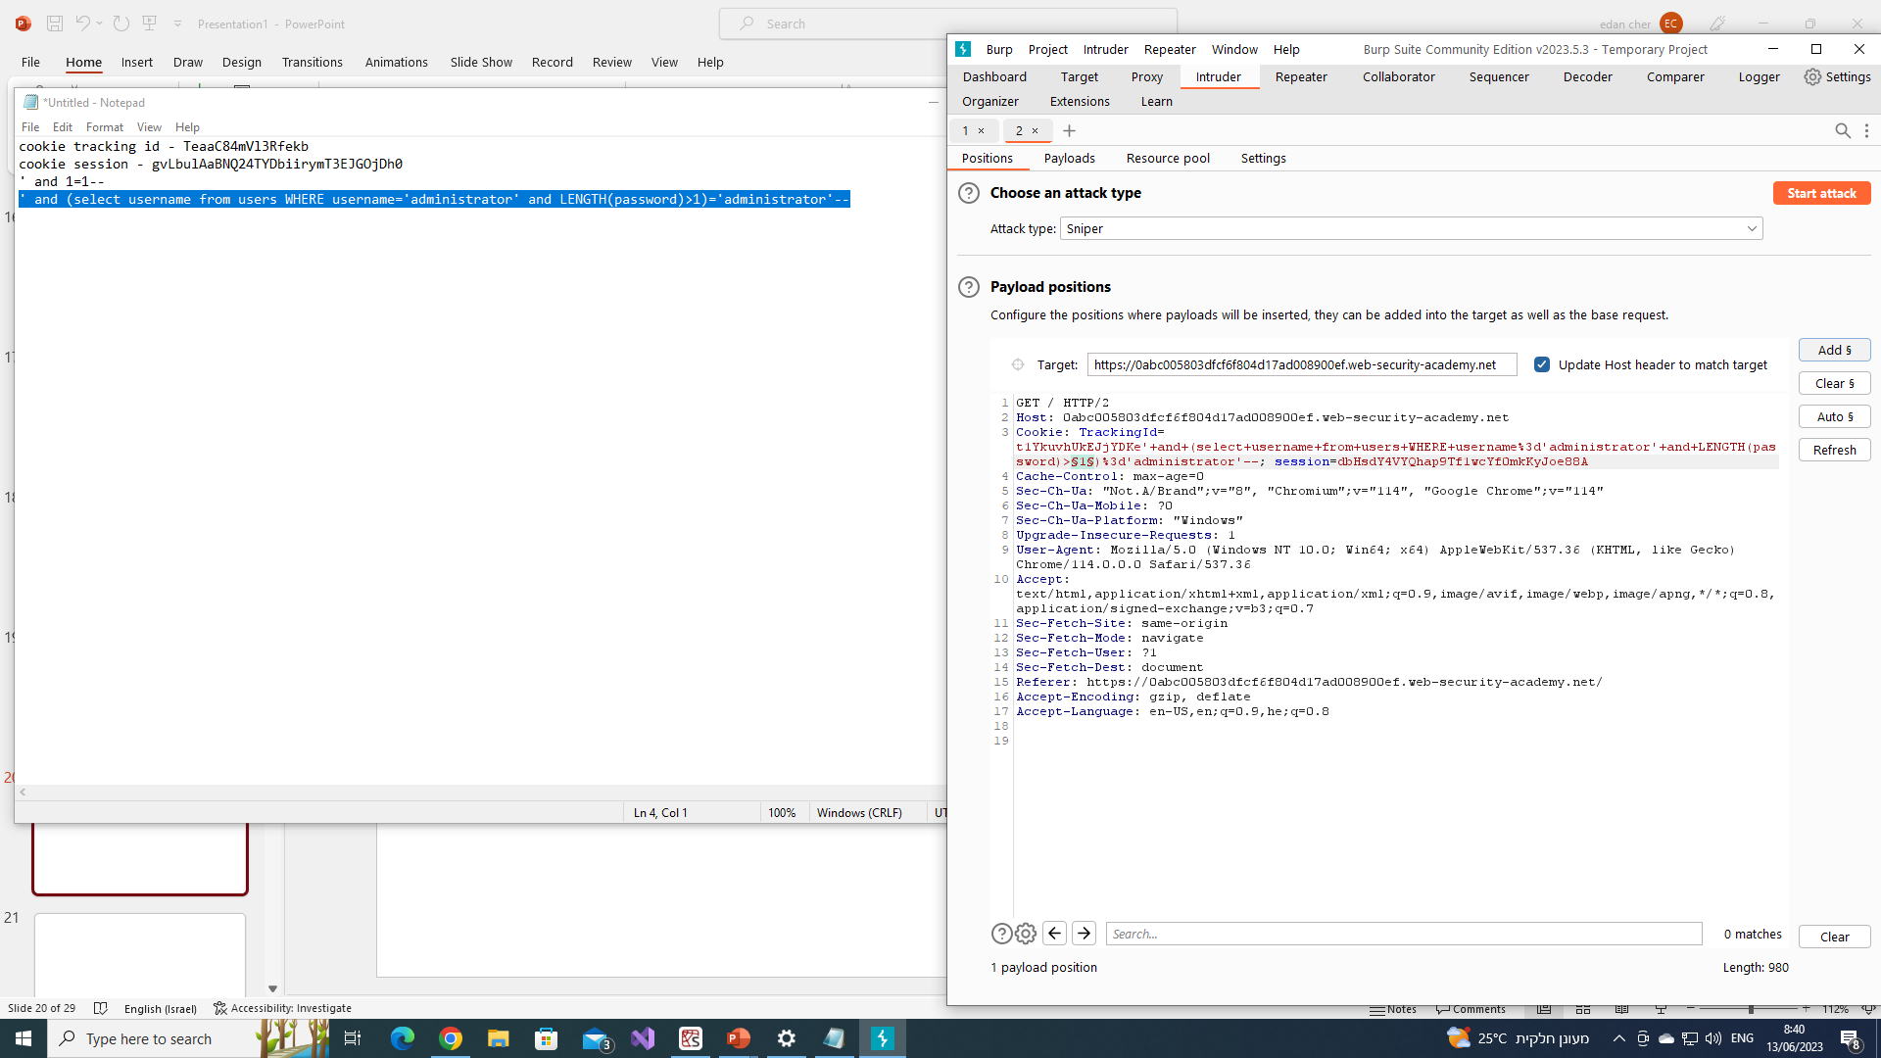
Blind SQLi - Boolean-based Blind SQLi
By marking the parameter we want to change and clicking on “add”, we will be able to change the parameter the way we want.

Slide 42
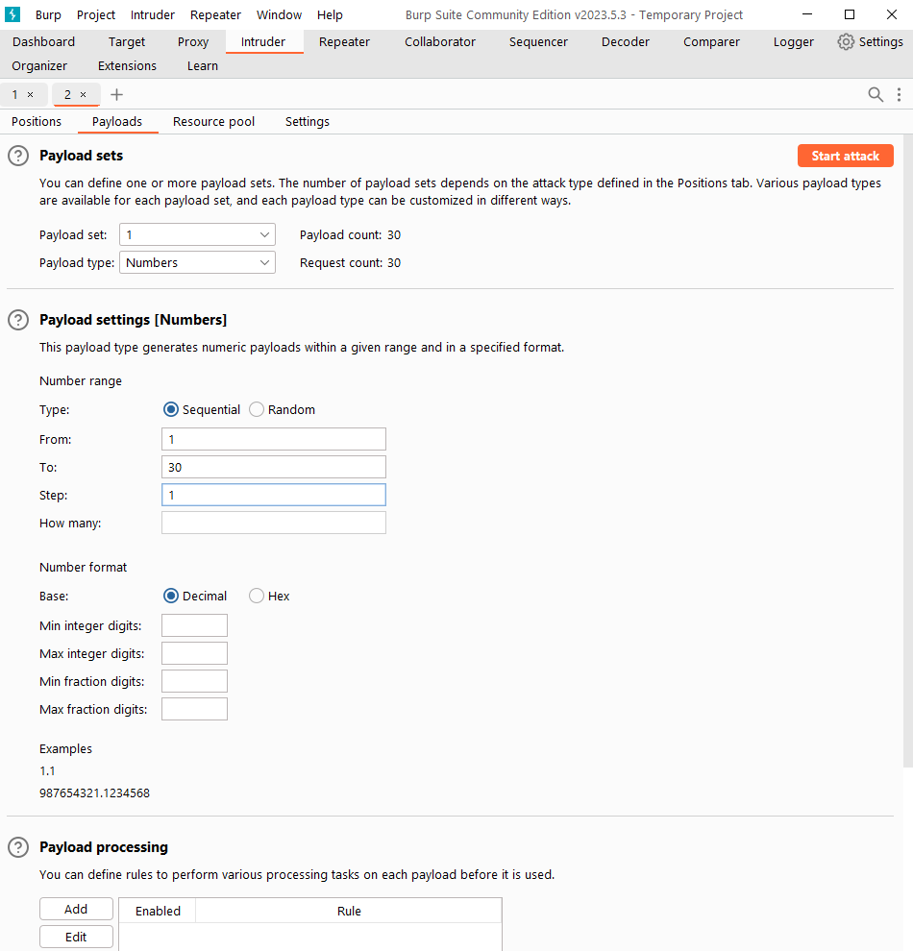
Blind SQLi - Boolean-based Blind SQLi
Setting up the way to increase/decrease the parameter.
By clicking on “Start attack”, the intruder will send 30 HTTP request with a different value for the parameter.
Increasing the parameter by 1, up to 30.

Slide 43
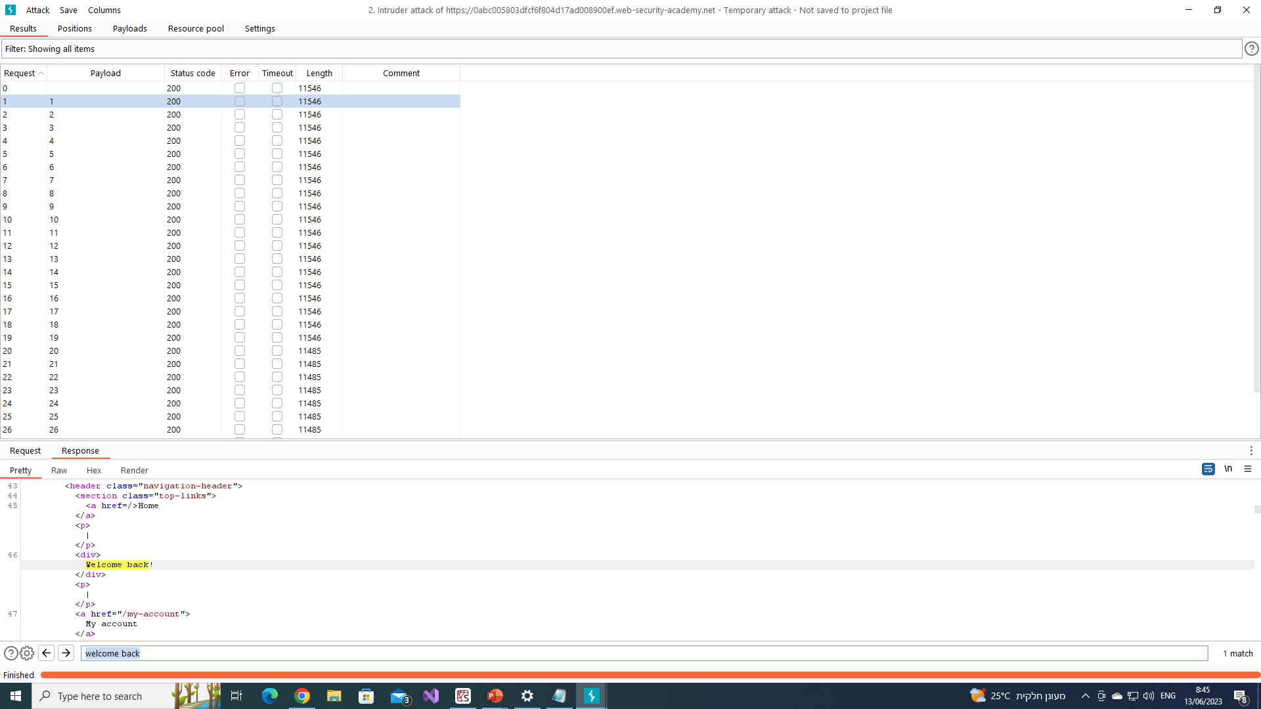
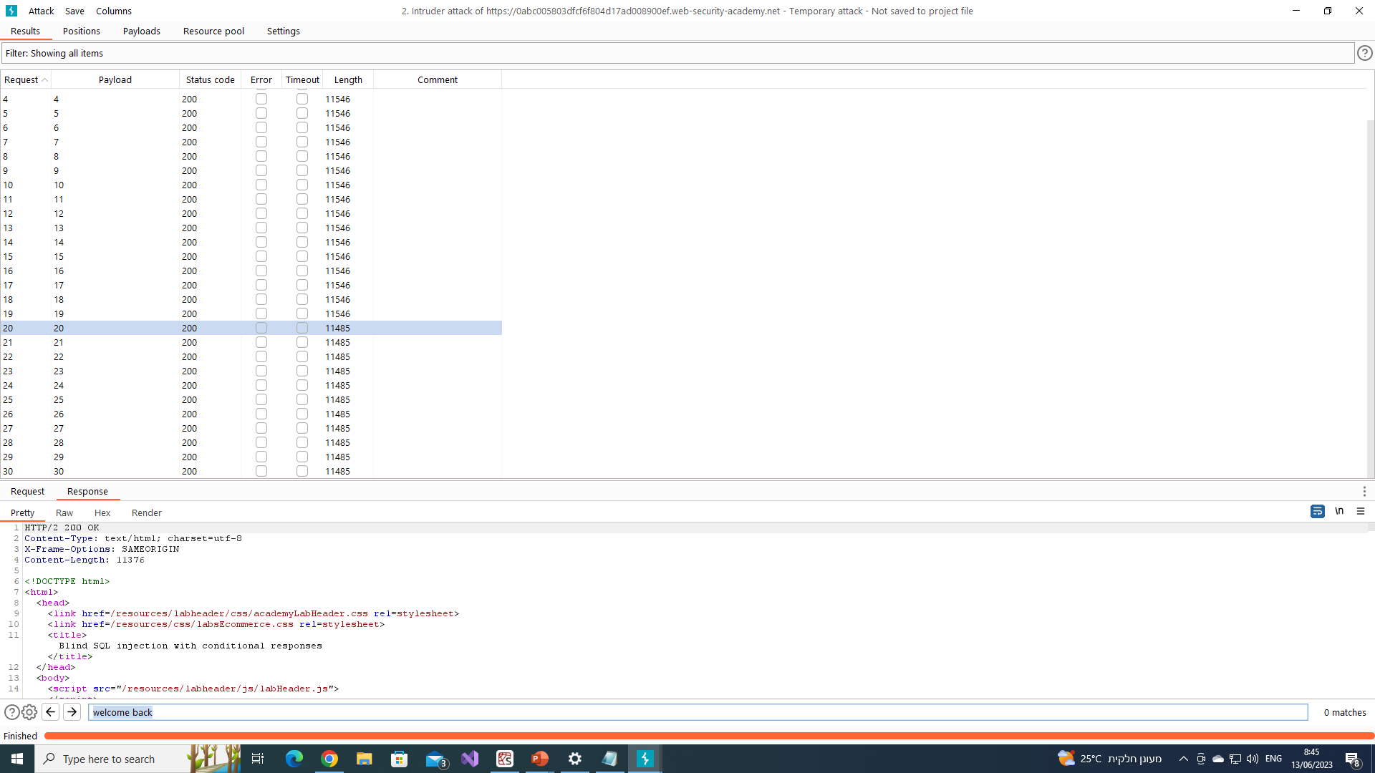
Blind SQLi - Boolean-based Blind SQLi
Checking the results of the attack.
From few slides before we know that when the length is bigger than 1, we get a “Welcome back!” massage, therefore we will look for the moment when the length of the Response is lower than the first one -> the moment when we stop getting the “Welcome back!” massage -> the password length.
Response’s length = 11546
The Response’s length changed to 11485 at length > 20

Slide 44
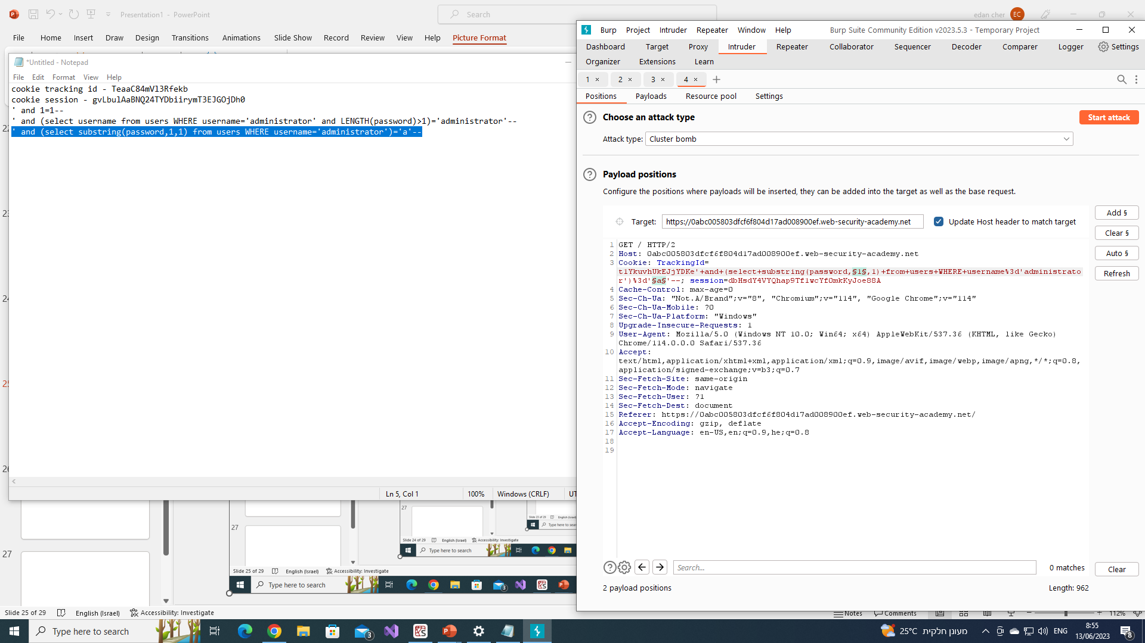
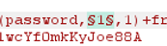
Blind SQLi - Boolean-based Blind SQLi
We will add to the original query –
' and (select substring(password,1,1) from users WHERE username='administrator')='a'--to find for each character of the administrator password, it’s own character.
We sent the new HTTP request (with the new query) to the intruder to find the password.
We use “Cluster bomb” Attack type to change 2 parameters in the same time.
Spot in Password
Character

Slide 45
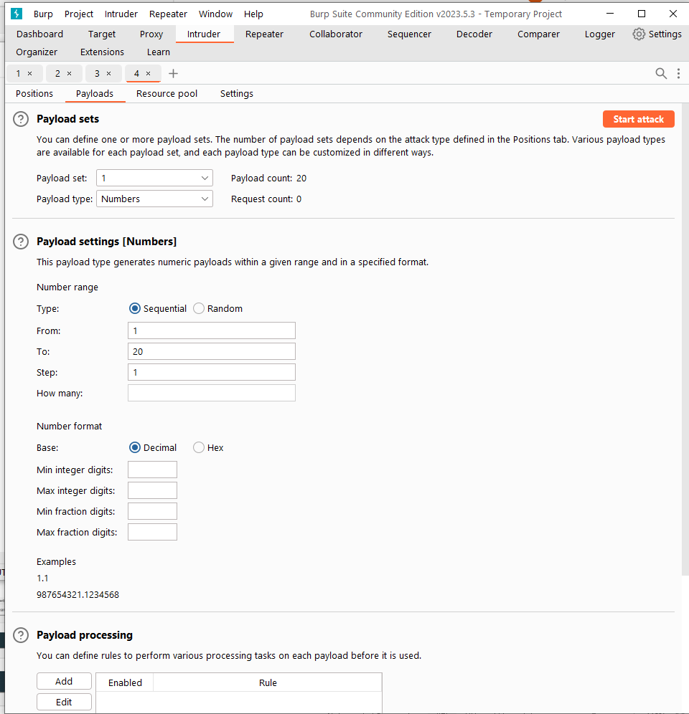
Blind SQLi - Boolean-based Blind SQLi
Setting up the way to increase/decrease the parameter.
Increasing the parameter by 1, up to 20 (the password length).

Slide 46
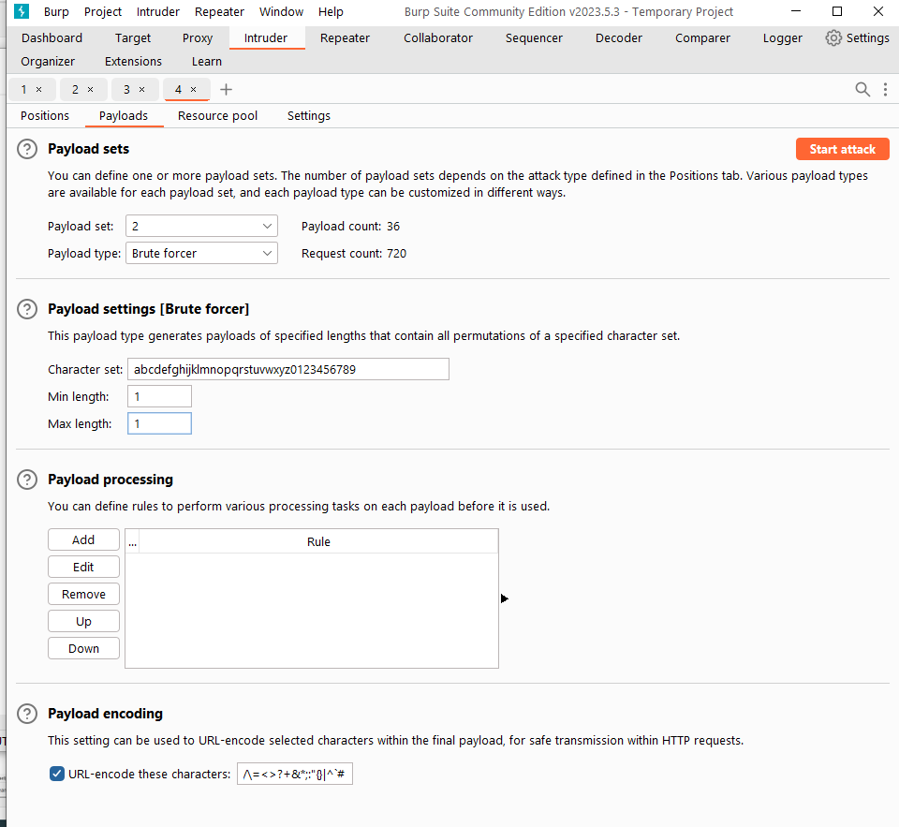
Blind SQLi - Boolean-based Blind SQLi
Setting up the way to increase/decrease the parameter.
To determine the character of every spot we will use the “Brute forcer” Payload type.
Checking only 1 character at a time.

Slide 47
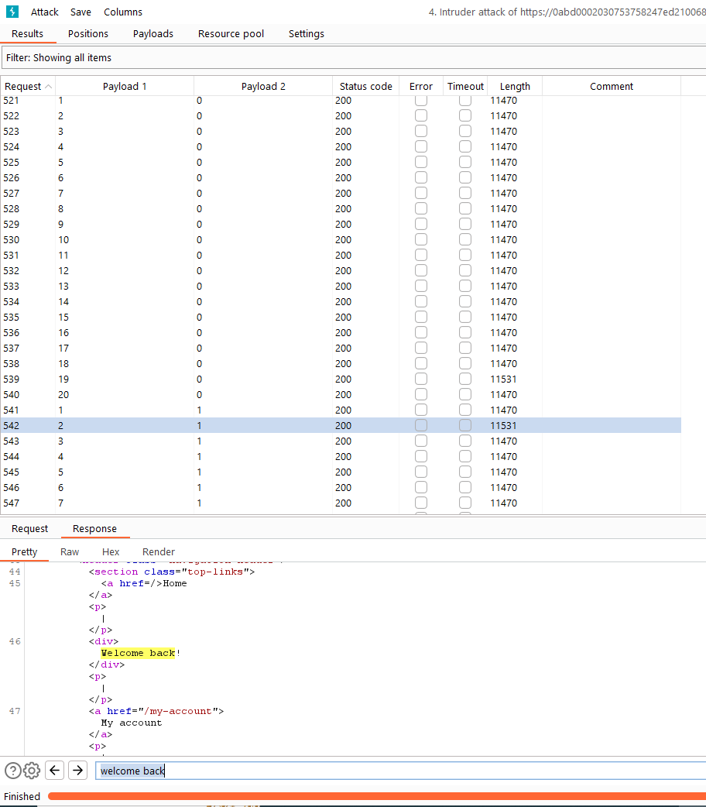
Blind SQLi - Boolean-based Blind SQLi
Setting up the way to increase/decrease the parameter.
Just like before, we will check for a change in the response’s length -> “Welcome back!” massage.
For example: on the current HTTP request we found that on the second spot the correct character is “1”.
We will search for the rest of the characters to find the password.
Note: in the professional version of Burp Suite you can filter the requests by text.

Slide 48
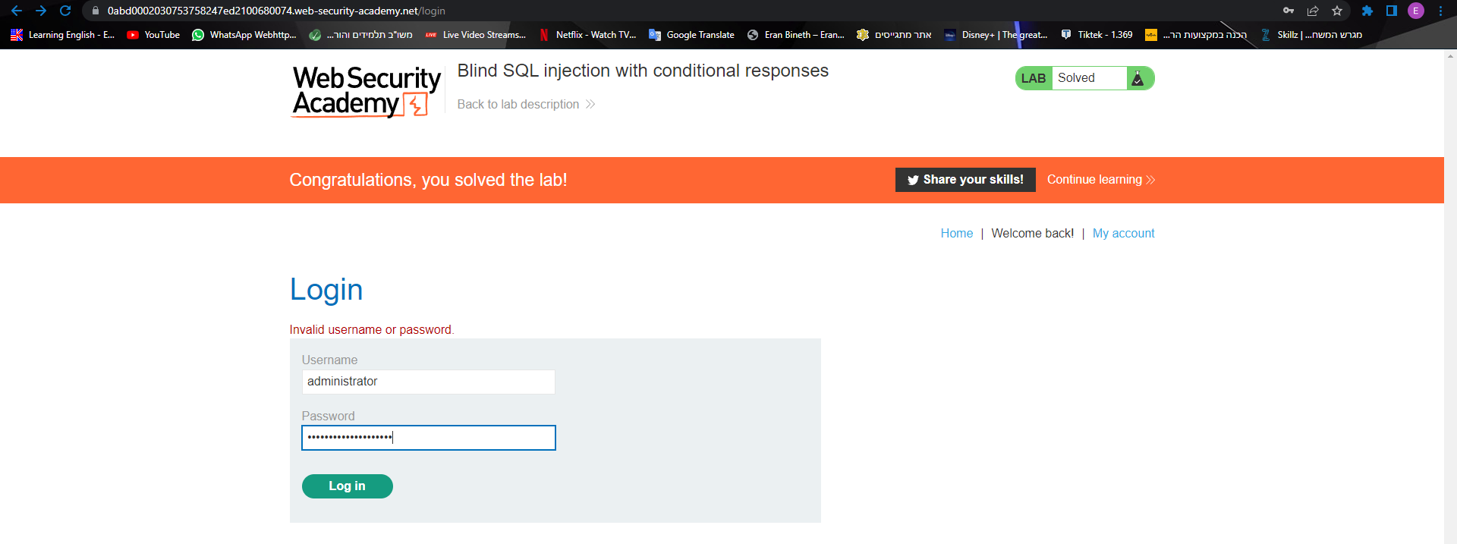
Blind SQLi - Boolean-based Blind SQLi
Finally we found the password using Boolean – based SQLi!!!

Slide 49
02
Blind SQLi
Time-based Blind SQLi
Time-based SQL Injection is an inferential (blind) SQL Injection technique that relies on sending an SQL query to the database which forces the database to wait for a specified amount of time (in seconds) before responding. The response time will indicate to the attacker whether the result of the query is TRUE or FALSE.
Depending on the result, an HTTP response will be returned with a delay, or returned immediately. This allows an attacker to infer if the payload used returned true or false, even though no data from the database is returned. This attack is typically slow (especially on large databases) since an attacker would need to enumerate a database character by character.

Slide 50
02
Blind SQLi
Time-based Blind SQLi
Using this technique will be similar to Boolean – based, but we will use the following queries to cause a time delay for different types of SQL databases:
Oracle - dbms_pipe.receive_message(('a'),10)
Microsoft - WAITFOR DELAY '0:0:10’
PostgreSQL - SELECT pg_sleep(10)
MySQL - SELECT SLEEP(10)

Slide 51
How to Protect?
Developers can prevent SQL Injection vulnerabilities in web applications by utilizing parameterized database queries with bound, typed parameters and careful use of parameterized stored procedures in the database.
This can be accomplished in a variety of programming languages including Java, .NET, PHP, and more.

Slide 52
How to Protect?
Additionally, developers, system administrators, and database administrators can take further steps to minimize attacks or the impact of successful attacks:
Keep all web application software components including libraries, plug-ins, frameworks, web server software, and database server software up to date with the latest security patches available from vendors.
Utilize the principle of least privilege(link is external) when provisioning accounts used to connect to the SQL database. For example, if a web site only needs to retrieve web content from a database using SELECT statements, do not give the web site's database connection credentials other privileges such as INSERT, UPDATE, or DELETE privileges. In many cases, these privileges can be managed using appropriate database roles for accounts. Never allow your web application to connect to the database with Administrator privileges (the "sa" account on Microsoft SQL Server, for instance).
Do not use shared database accounts between different web sites or applications.

Slide 53
How to Protect?
Validate user-supplied input for expected data types, including input fields like drop-down menus or radio buttons, not just fields that allow users to type in input.
Configure proper error reporting and handling on the web server and in the code so that database error messages are never sent to the client web browser. Attackers can leverage technical details in verbose error messages to adjust their queries for successful exploitation.

Slide 54
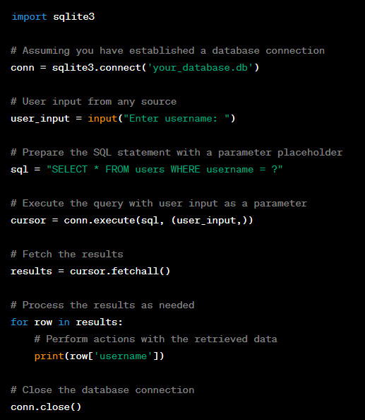
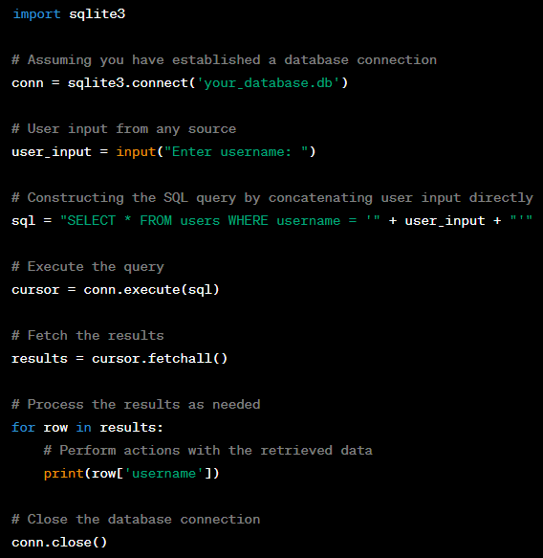
How to Protect?
SECURED
NOT SECURED

Slide 55
WHAT IS NoSQL?
NoSQL, also referred to as “not only SQL”, “non-SQL”, is an approach to database design that enables the storage and querying of data outside the traditional structures found in relational databases. While it can still store data found within relational database management systems (RDBMS), it just stores it differently compared to an RDBMS. The decision to use a relational database versus a non-relational database is largely contextual, and it varies depending on the use case.
Instead of the typical tabular structure of a relational database, NoSQL databases, house data within one data structure, such as JSON document. Since this non-relational database design does not require a schema, it offers rapid scalability to manage large and typically unstructured data sets.
NoSQL is also type of distributed database, which means that information is copied and stored on various servers, which can be remote or local. This ensures availability and reliability of data. If some of the data goes offline, the rest of the database can continue to run.

Slide 56
NoSQL Injection
NoSQL injection is a type of vulnerability where an attacker is able to inject arbitrary text into NoSQL queries. NoSQL injections are very similar to the traditional SQL injection attack, except that the attack is against a NoSQL database. NoSQL is a general term for any database that does not use SQL, a common database management system (DBMS) that utilizes NoSQL is MongoDB.

Slide 57
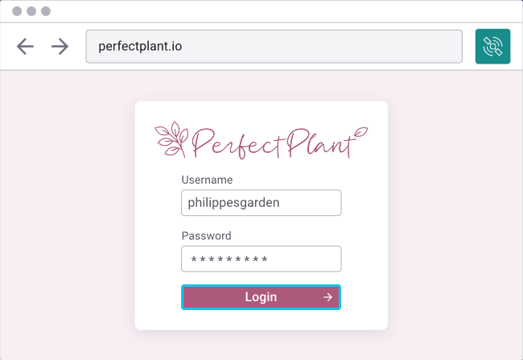
NoSQL Injection
In this lab we will try to hack into this website and cause serious damage using NoSQL injection.

Slide 58
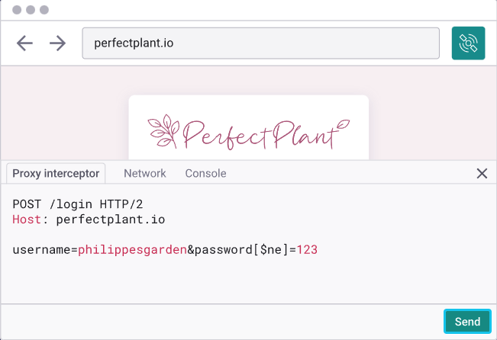
NoSQL Injection
As you can see, we weren’t able to log into the website by guessing a username or a password, therefore we will change the NoSQL code in the HTTP request to leg ourselves in.
From username=philippergarde&password=123
We changed the code to
username=philippergarde&password[$ne]=123
We tricked the code to let us log in without knowing the password by telling it the username and the password is not equal to “123”

Slide 59
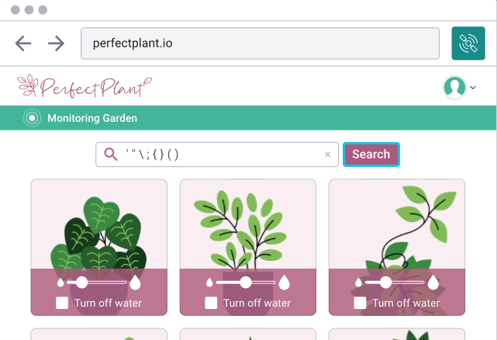
NoSQL Injection
After logging in, we arrived to this page.
We will try to cause damage by entering weird characters and see how the website reacts.

Slide 60
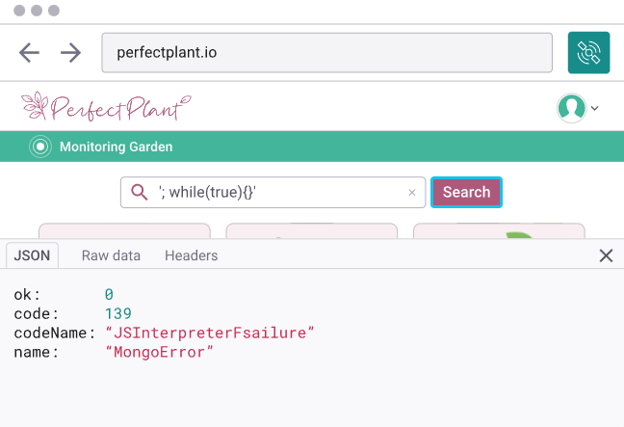
NoSQL Injection
As you can see, the website did not react well and stumbled upon an error.
We will exploit this error and enter a malicious code to cause damage to the website.
We entered the following code to the search bar to make an infinite loop and cause the website to crash:
‘;while(true){}’

Slide 61

THANK YOU FOR LISTENING ☺

